Slide 1
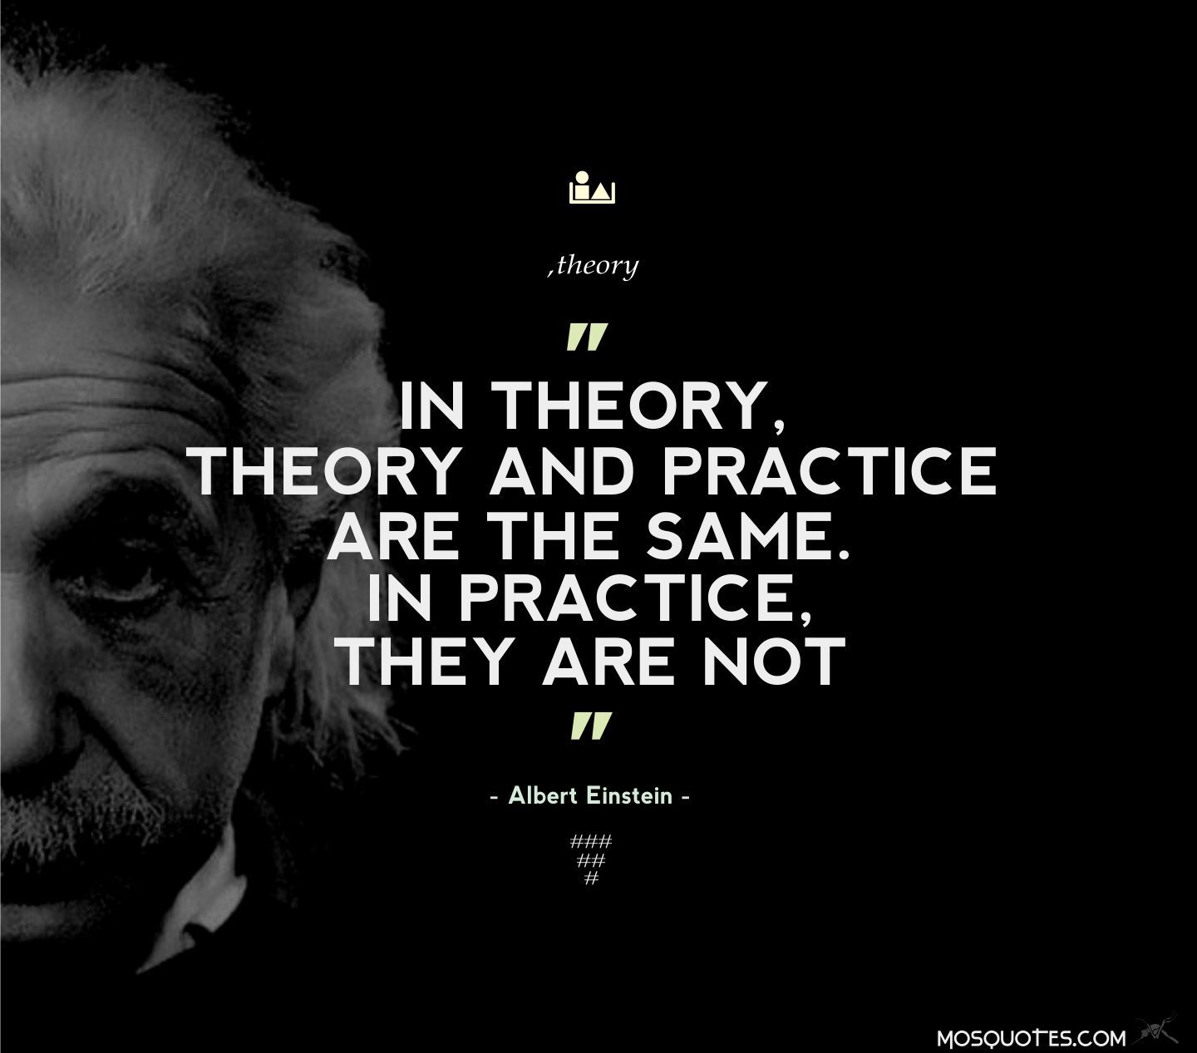
Practicum Project: Taking the course into the wild
December 6, 2018
Purpose, Direction & Last Resort Datasets

Slide 2
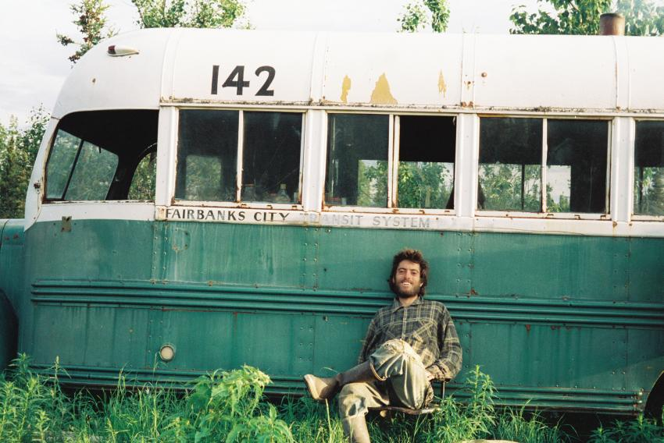
Practicum Project
Identify a data set that is of some importance to you
What questions do you have about it?
Future predictions related to it
Statistically significant differences between subjects within it
Explore it in a new way to get insight
Develop a model to classify future entries

Slide 3


Practicum Project
Follow the work flow you have learned in this course.
For your project attempt to categorize:
How accurate your analysis is
Where uncertainty in your results lie in terms of you the analysis can be generalized.

Slide 4
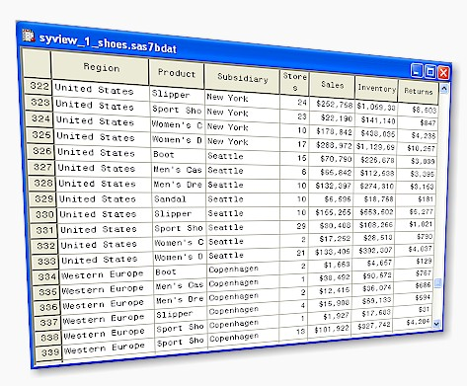

Practicum Project
Your work with this data set at the end of the week will serve as your exam.
If you still have not found a data set we have some to choose from.
Note: Since these have little meaning to you, your work is likely to be less useful.
These are meant to be used as a last resort.

Slide 5
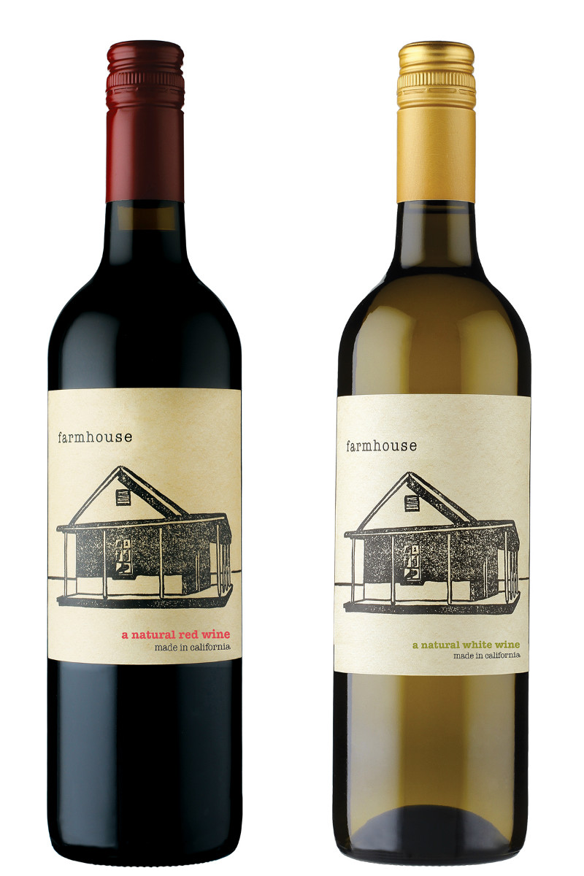

Practicum Project
Datasets at:
https://github.com/rossgore/practicum-projects
Overview of datasets
Wine Quality (Regression) – Properties of red and white vinho verde wine samples from the north of Portugal. The goal is to model wine quality based on physicochemical tests.
Credit Card Default (Classification) – Predicting credit card default is a valuable and common use for machine learning. This dataset includes demographics, payment history, credit, and default data.

Slide 6
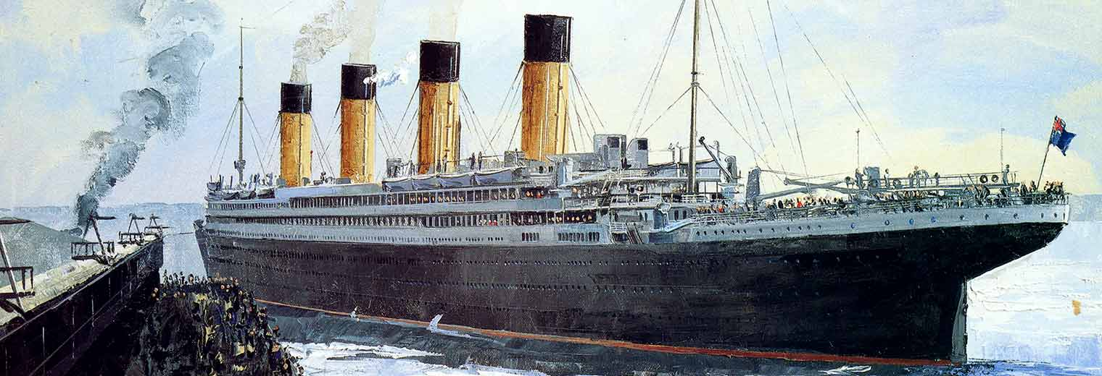
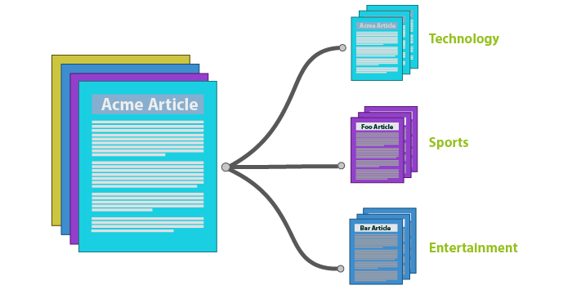
Practicum Project
Datasets at:
https://github.com/rossgore/practicum-projects
Overview of datasets
Titanic (Classification) – contains data for 887 of the real Titanic passengers. Each row represents one person. The columns describe different attributes about the person including whether they survived (S), their age (A), their passenger-class (C), their sex (G) and the fare they paid (X).
Newsgroup (Classification) - Collection of approximately 20,000 newsgroup documents, partitioned (nearly) evenly across 20 different newsgroups.

Slide 7



Practicum Project
Datasets at:
https://github.com/rossgore/practicum-projects
Overview of datasets
Iris (Classification) - 50 samples from each of three species of Iris (Iris setosa, Iris virginica and Iris versicolor). Four features were measured from each sample: the length and the width of the sepals and petals, in centimeters.
Census (Classification) - Collection of demographic characteristics of an individual. Goal is to predict if the person makes > $50,000 per year.

Slide 8

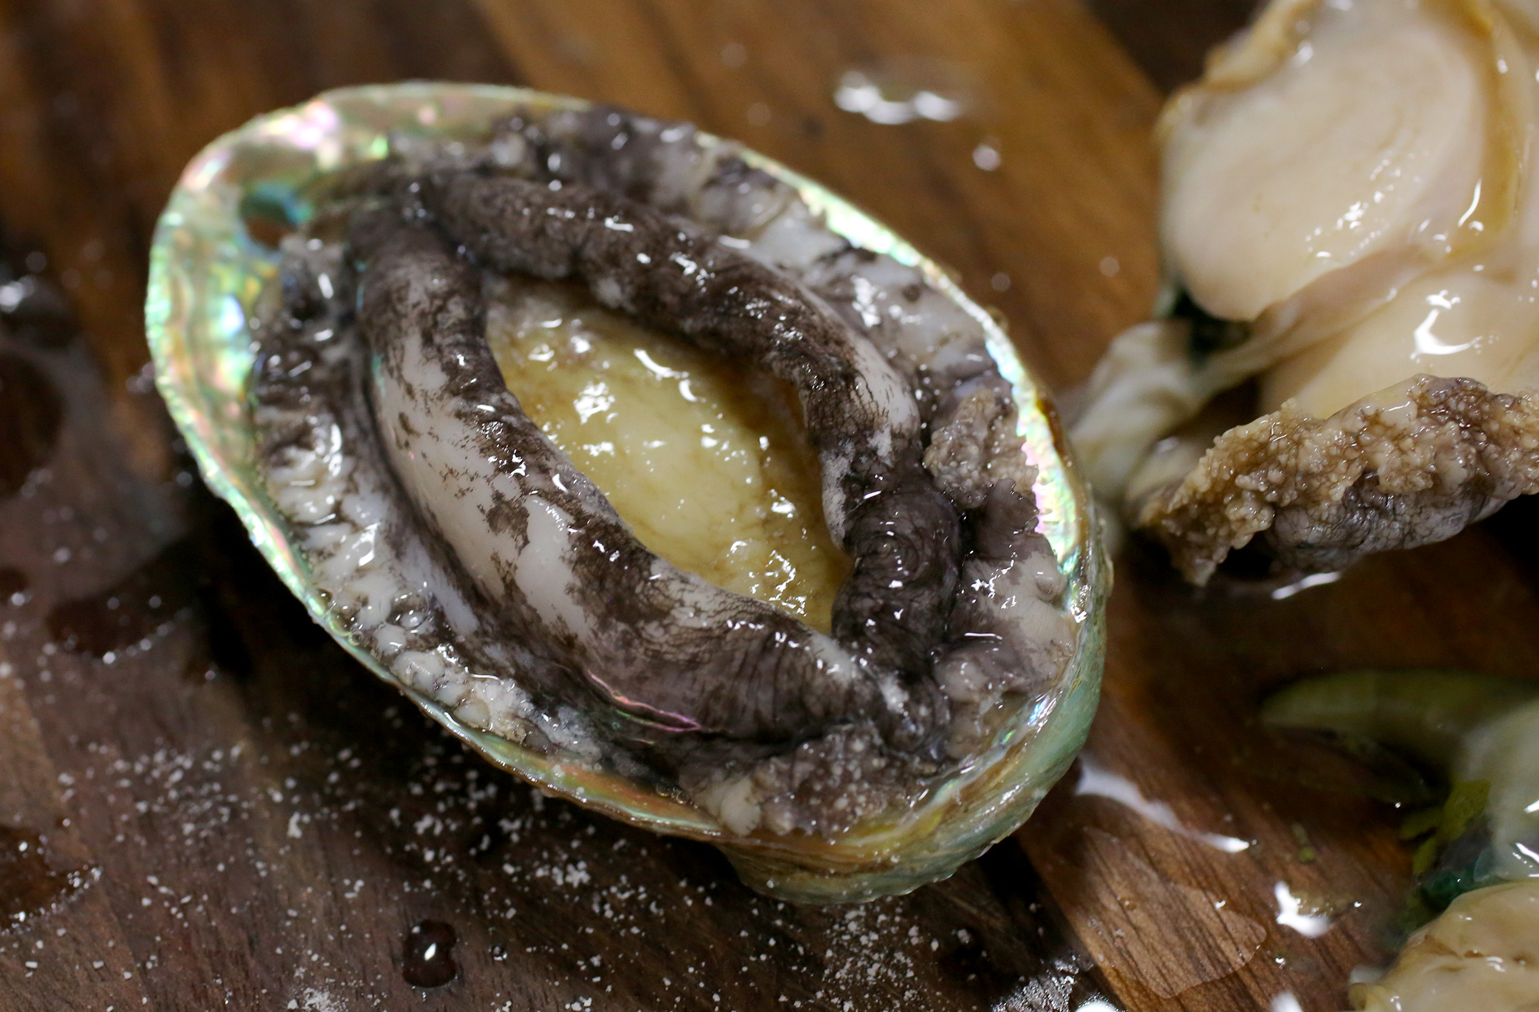
Practicum Project
Datasets at:
https://github.com/rossgore/practicum-projects
Overview of datasets
Abalone (Classification / Regression) - Predicting the age of abalone from physical measurements. The age of abalone is determined by cutting the shell through the cone, staining it, and counting the number of rings through a microscope. Other measurements, which are easier to obtain, are used to predict the age.
IMDB (Classification / Regression) – Lots of attributes of IMDB movies. Attempt to predict budget, imdb score, color, duration, etc.

Slide 9
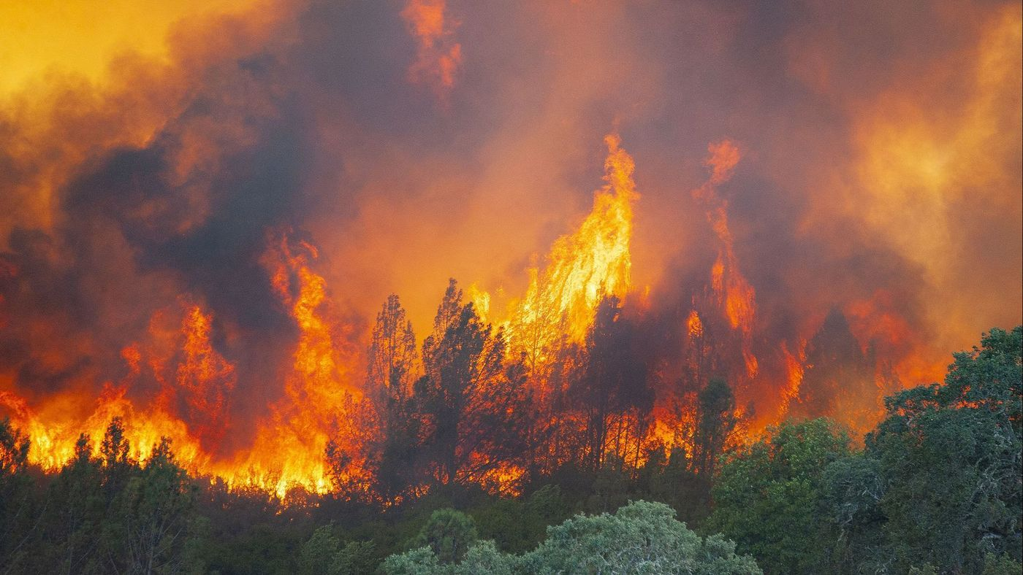
Practicum Project
Datasets at:
https://github.com/rossgore/practicum-projects
Overview of datasets
Forest Fires (Regression) - predict the burned area of forest fires, in the northeast region of Portugal, by using meteorological and other data.

